Slide 1
Reconciling SCXML Statechart Representations and Event-B Lower Level Semantics
Karla Morris : Sandia National Laboratories, CA, USA
Colin Snook : University of Southampton, UK

Slide 2
Outline
Motivation
Model Representations
SCXML
iUML-B
Similarities & Differences in the Semantics
Extensions to SCXML
Prototype System Model
Future Work
Conclusions

Slide 3
Motivation
Event-B provides verification by formal proof…
… but notation is restricted to simplify verification.
Engineers are used to a richer notation..
.. they may find the restrictions difficult to accept.
iUML-B State-machines help but still close to Event-B.
Can Harel style state-chart semantics be reconciled with iUML-B?
We investigate a translation from SCXML state-charts to iUML-B state-machines (and hence to Event-B).

Slide 4
SCXML: State Chart eXtensible Markup Language
State Chart XML :
State Machine Notation for Control Abstraction
XML notation
Harel Statecharts
Executable (via simulator tools)
Related to CCXML Call Control XML, event-based telephony

Slide 5
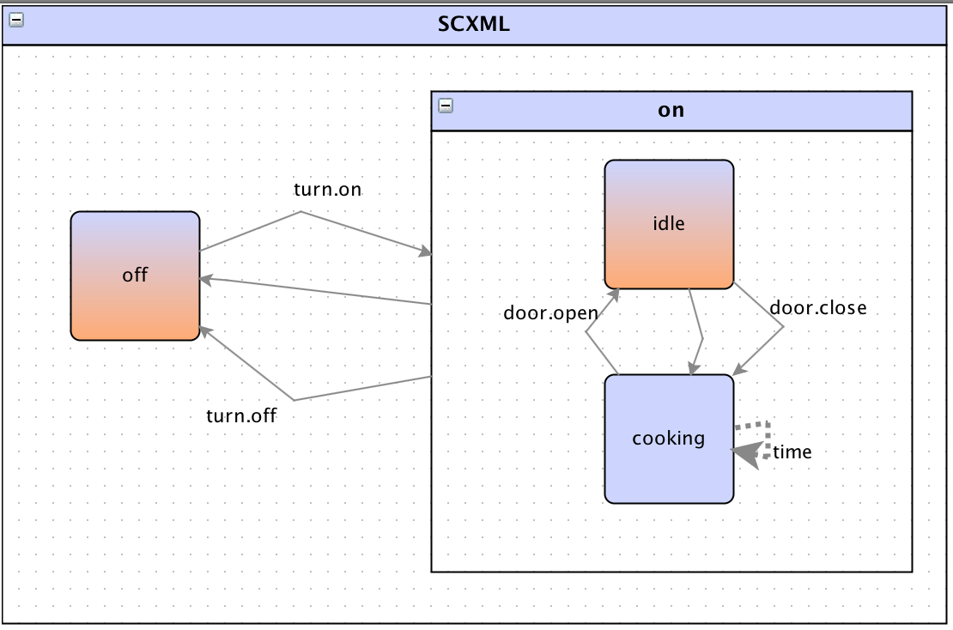
SCXML
<state id="on">
<initial>
<transition target="idle"/>
</initial>
<!-- on/pause state -->
<transition event="turn.off" target="off"/>
<transition cond="timer = cook_time" target="off"/>
<state id="idle">
<!-- default immediate transition if door is shut -->
<transition cond="door_closed" target="cooking"/>
<transition event="door.close" target="cooking">
<assign location="door_closed" expr="true"/>
<!-- start cooking -->
</transition>
</state>
<state id="cooking">
<transition event="door.open" target="idle">
<assign location="door_closed" expr="false"/>
</transition>
<!-- a 'time' event is seen once a second -->
<transition event="time">
<assign location="timer" expr="timer + 1"/>
</transition>
</state>
</state>
</scxml>
<?xml version="1.0"?>
<scxml xmlns="http://www.w3.org/2005/07/scxml"
version="1.0"
datamodel="ecmascript"
initial="off">
<!--trivial 5 second microwave oven example -->
<datamodel>
<data id="cook_time" expr="5"/>
<data id="door_closed" expr="true"/>
<data id="timer" expr="0"/>
</datamodel>
<state id="off">
<!-- off state -->
<transition event="turn.on" target="on"/>
</state>

Slide 6
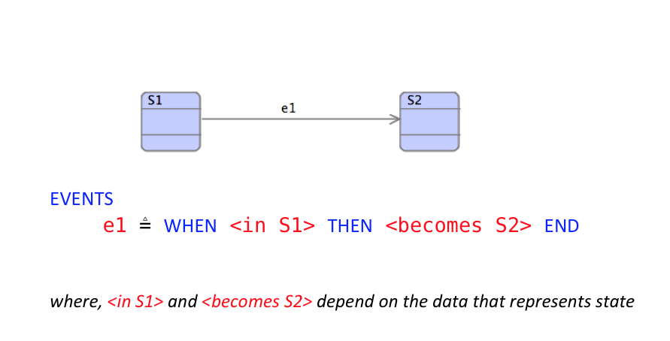
iUML-B Statemachines

Slide 7
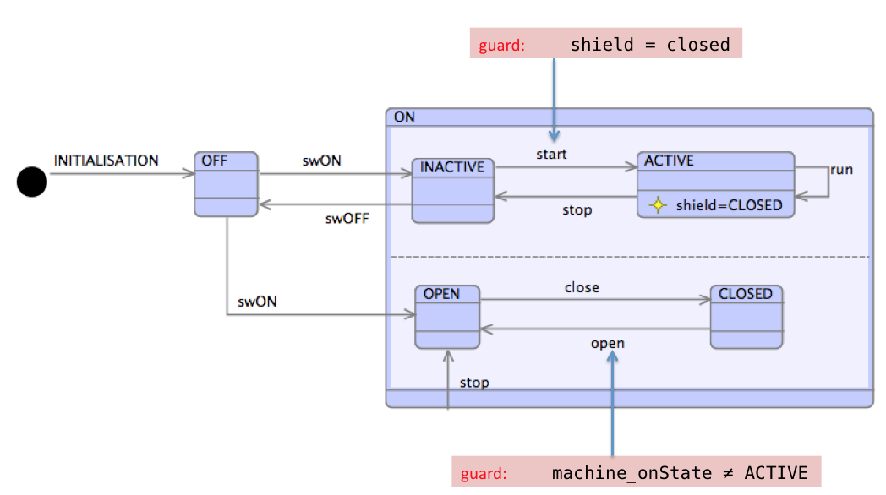
iUML-B Statemachines

Slide 8
Similarities between SCXML and iUML-B
Hierarchical nested state-charts
Transitions with
Conditions / Guards
Actions
States can have Entry and Exit Actions
(use with care in iUML-B)

Slide 9
Differences between SCXML and iUML-B
Event-B has..
Refinement
Invariants
Atomic Actions
SCXML has..
External Trigger events
Hence transitions do not have a name/label
Sequential actions
Run to Completion – Big step/little step

Slide 10
SCXML Extensions
XML tools allow new meta-model ‘namespaces’ to be introduced.
Existing SCXML tools will ignore them
Needed in order to support:
Refinement levels (new attribute <iumlb:refinement …>)
Invariants (new element <iumlb:invariant …>)
Guards (new element <iumlb:guard …>)

Slide 11
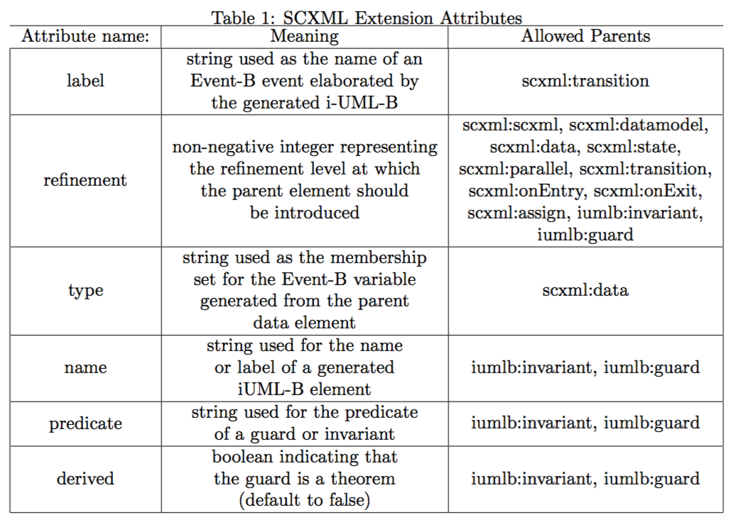
SCXML Extension Attributes

Slide 12
Example extended SCXML (extensions are captured in red)
<datamodel iumlb:refinement="2">
<data expr="false" id="Gate_In.Block" iumlb:type="BOOL"/>
</datamodel>
<!-- Other model details -->
<state id="BLOCKED">
<transition cond="[On_In.CardAccept==true]" target="UNBLOCKED">
<iumlb:guard name="gd1" predicate="On_In.CardAccept==true" refinement="2"/>
<assign expr="true" location="Gate_In.Block" iumlb:refinement="3"/>
</transition>
<onentry>
<assign expr="true" location="Gate_In.Block"/>
<assign expr="false" location="On_In.Reset"/>
</onentry>
<onexit>
<assign expr="false" location="Gate_In.Block"/>
</onexit>
<iumlb:invariant predicate="Gate_In.Block == TRUE" name="GateCondition"/>
</state>

Slide 13
Initial translation supports..
Data models
Hierarchical nested statemachines
Parrallel Statemachines
‘When’ Transitions (label)
Transition parameters, guards and actions
Invariants
Initial and Final states
Refinement (superposition only)

Slide 14
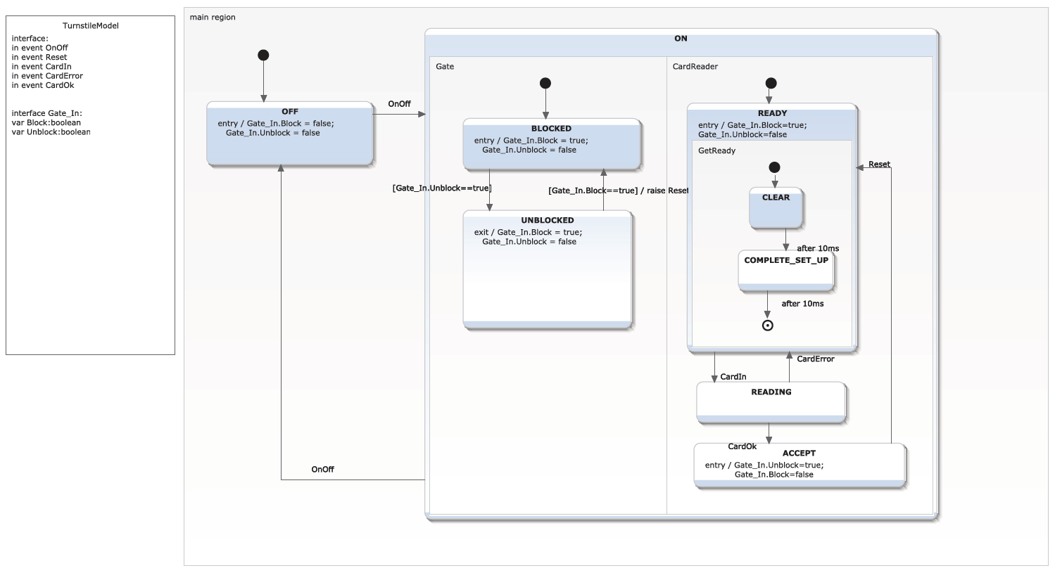
Diagram of SCXML

Slide 15
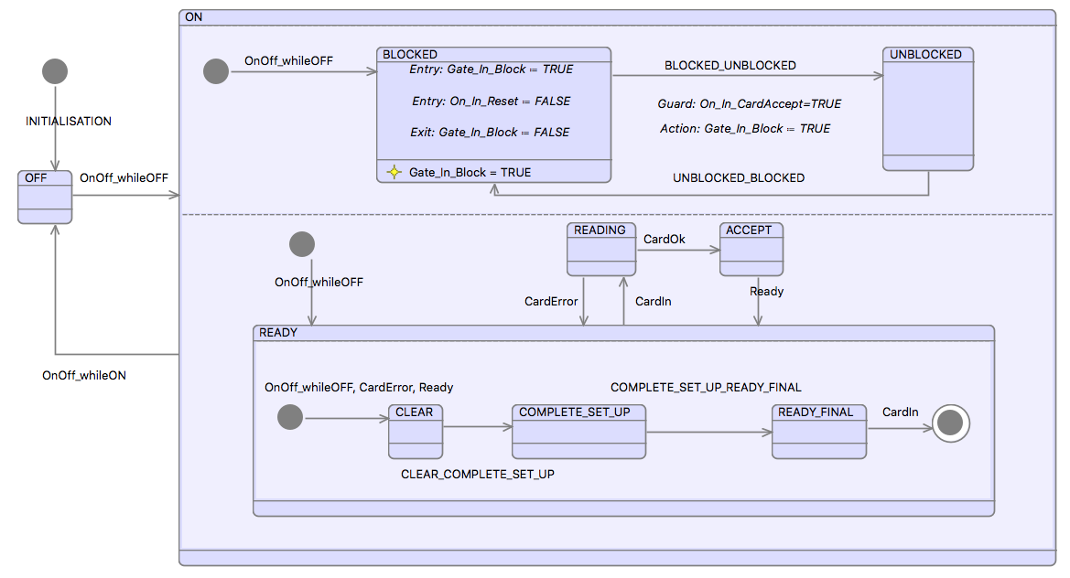
Example – generated iUML-B

Slide 16
Next steps
Try modelling the run to completion semantics
E.g. trigger events create a token,
A new token can only be consumed when no transitions are enabled
Try enforcing transition run-to-completion sequences
Still omit sequencing of actions

Slide 17
Enhance iUML-B to support triggers
First Strategy:
iUML-B Statemachines will own a collection of triggers.
Each trigger will generate an Event-B BOOL variable.
(Note simplification of SCXML, which permits several triggers of a kind to be queued)
Transitions may reference a trigger.
The reference will generate a guard, <trigger variable> = TRUE
And an action <trigger variable> := FALSE.
Transitions may own a collection of ‘Raise’ actions that reference an internal trigger.
This will generate an action <trigger variable> := TRUE.
Trigger may be designated as external event.
An trigger event will be generated to create a new trigger (<trigger variable> := TRUE )
when it has been consumed ( <trigger variable> = FALSE ) and
no transitions are enabled. (run to completion)
A partial ‘run-to-completion’ semantics will be introduced by disabling all trigger events while any external or internal transition is enabled.

Slide 18
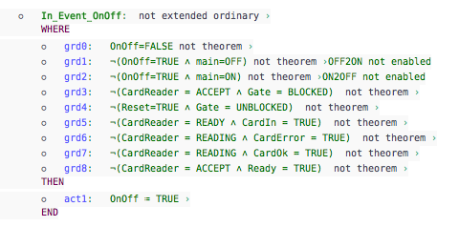
External Trigger Event
Old trigger has been consumed
No transitions enabled
Raise new trigger

Slide 19
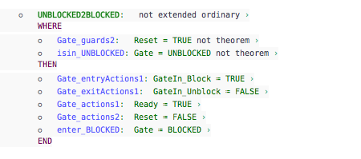
Triggered transition
The trigger guard
Raise an internal trigger
Consume the external trigger

Slide 20
Enhance iUML-B to support triggers
Second Strategy:
iUML-B Statemachines refine a basis Event-B machine
Trigger events to be consumed in current step are accumulated in a set NOW
Trigger events to be observed in next step are accumulated in a set NEXT
Triggers events generation
An event representing an external trigger
A transition with a “Raise’’ action
All triggers are added to NEXT
Future transitions event
Adds guard to define T = {<theNewTrigger>}
Adds guard to define R = {<theNewRaisedTriggers>}
Future trigger event
Adds singleton trigger t : futureTriggers<N> to set NEXT
A partial ‘run-to-completion’ semantics will be introduced by disabling step event while any external or internal transition is enabled
New guards are added at each refinement level for each new transition
Copies NEXT into NOW
Set NEXT to empty

Slide 21
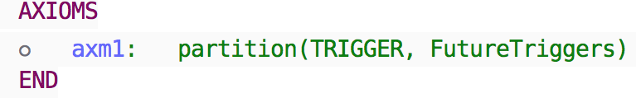
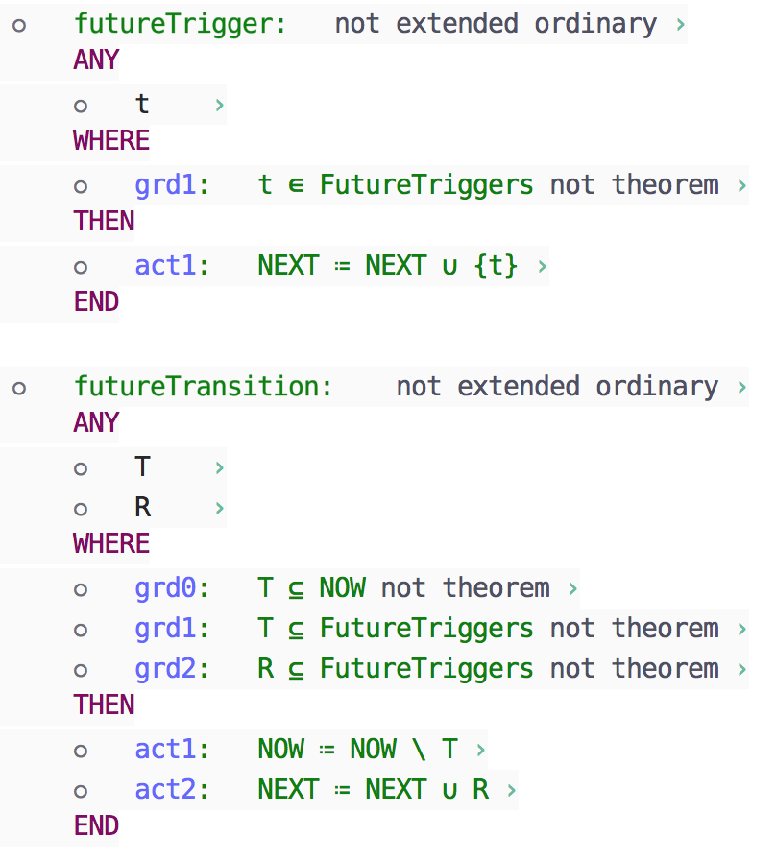
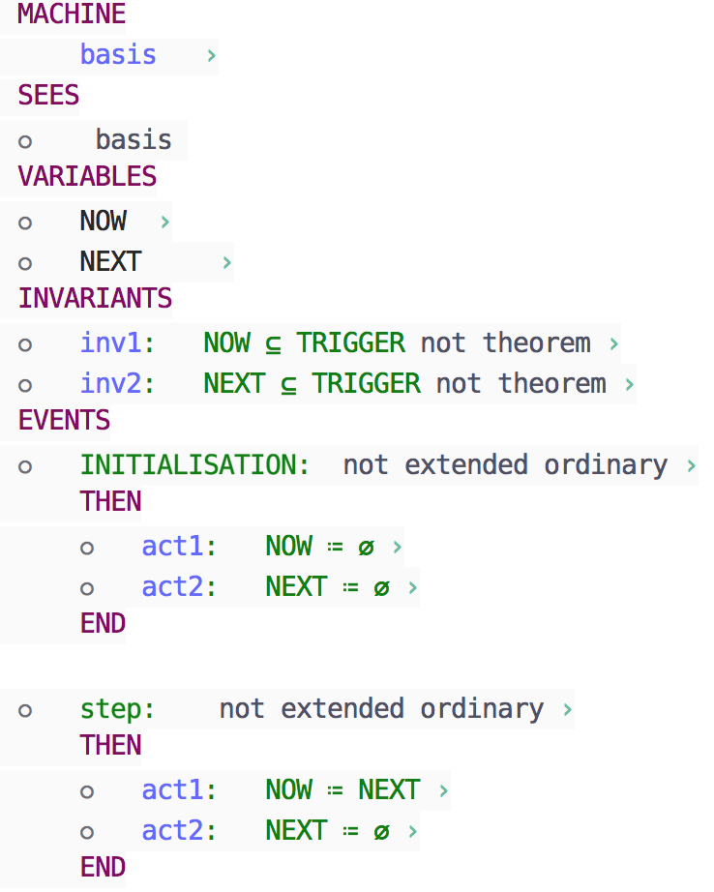
Enhance iUML-B to support triggers
Second Strategy:

Slide 22
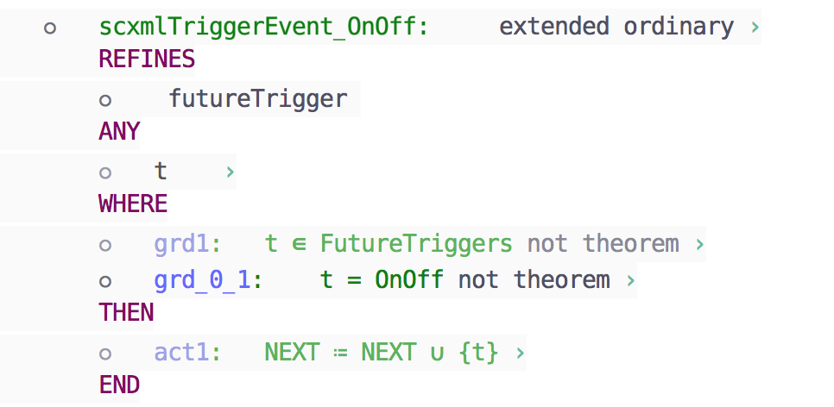
External Trigger Event
Define new Trigger
Add new trigger the NEXT set

Slide 23
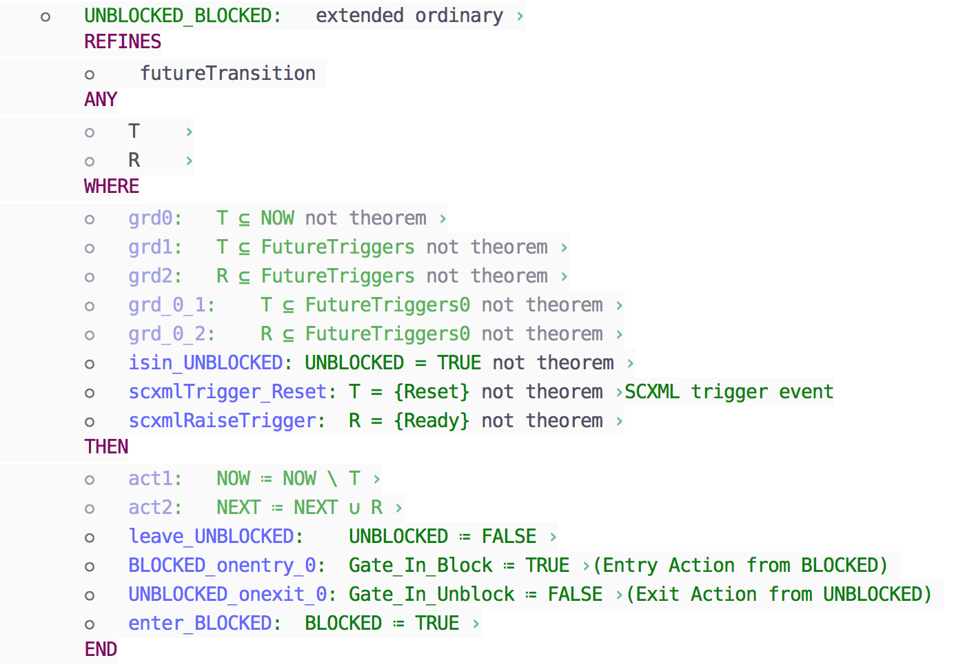
Triggered transition
The trigger guard
Raise an internal trigger
Consume the external trigger

Slide 24
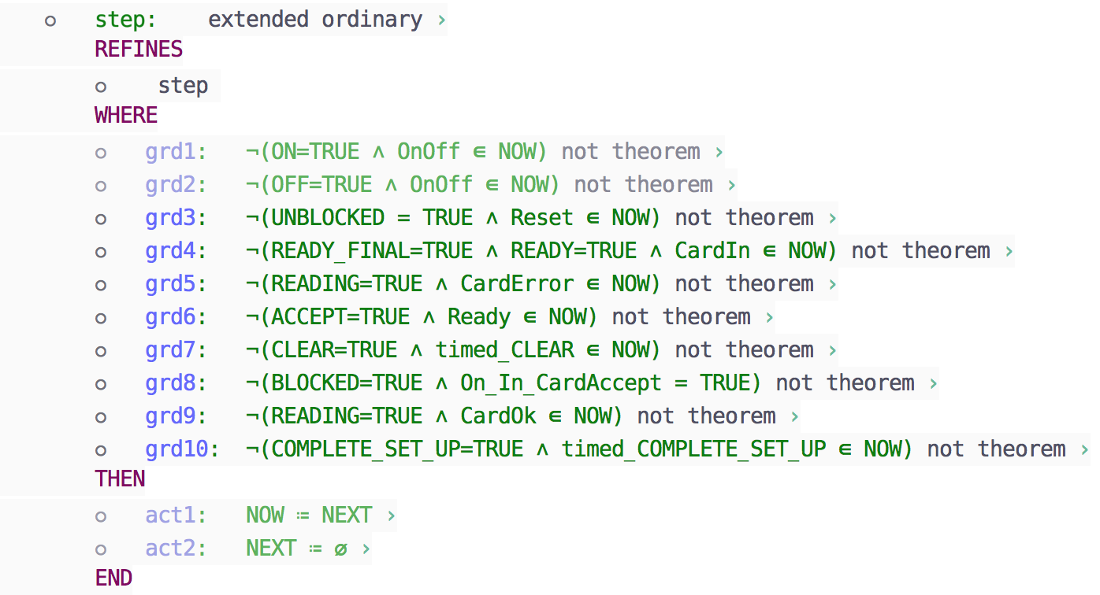
Step Event
No transitions enabled
Set of triggers to be consumed in this step
Clears NEXT set

Slide 25
Conclusions
Strong motivation from engineers
Difficult to reconcile semantic differences
Run-to-completion, Sequential execution
We adopt a compromise
Support what we can
Add extensions where necessary
Otherwise, restrict SCXML

Slide 26
Thank you
Questions?

Slide 27
Next steps
Try modelling the run to completion semantics
E.g. trigger events create a token,
A new token can only be consumed when no transitions are enabled
Try enforcing transition run-to-completion sequences
Still omit sequencing of actions

Slide 28
Enhance iUML-B to support triggers
iUML-B Statemachines will own a collection of triggers.
Each trigger will generate an Event-B BOOL variable.
(Note simplification of SCXML, which permits several triggers of a kind to be queued).
Transitions may reference a trigger.
The reference will generate a guard, <trigger variable> = TRUE
And an action <trigger variable> := FALSE.
Transitions may own a collection of ‘Raise’ actions that reference an internal trigger.
This will generate an action <trigger variable> := TRUE.
Trigger may be designated as external event.
An trigger event will be generated to create a new trigger ( <trigger variable> := TRUE )
when it has been consumed ( <trigger variable> = FALSE ) and
no transitions are enabled. (run to completion)
A partial ‘run-to-completion’ semantics will be introduced by disabling all trigger events while any external or internal transition is enabled.

Slide 29
External Trigger Event
Old trigger has been consumed
No transitions enabled
Raise new trigger

Slide 30
Triggered transition
The trigger guard
Raise an internal trigger
Consume the external trigger

